Slide 1
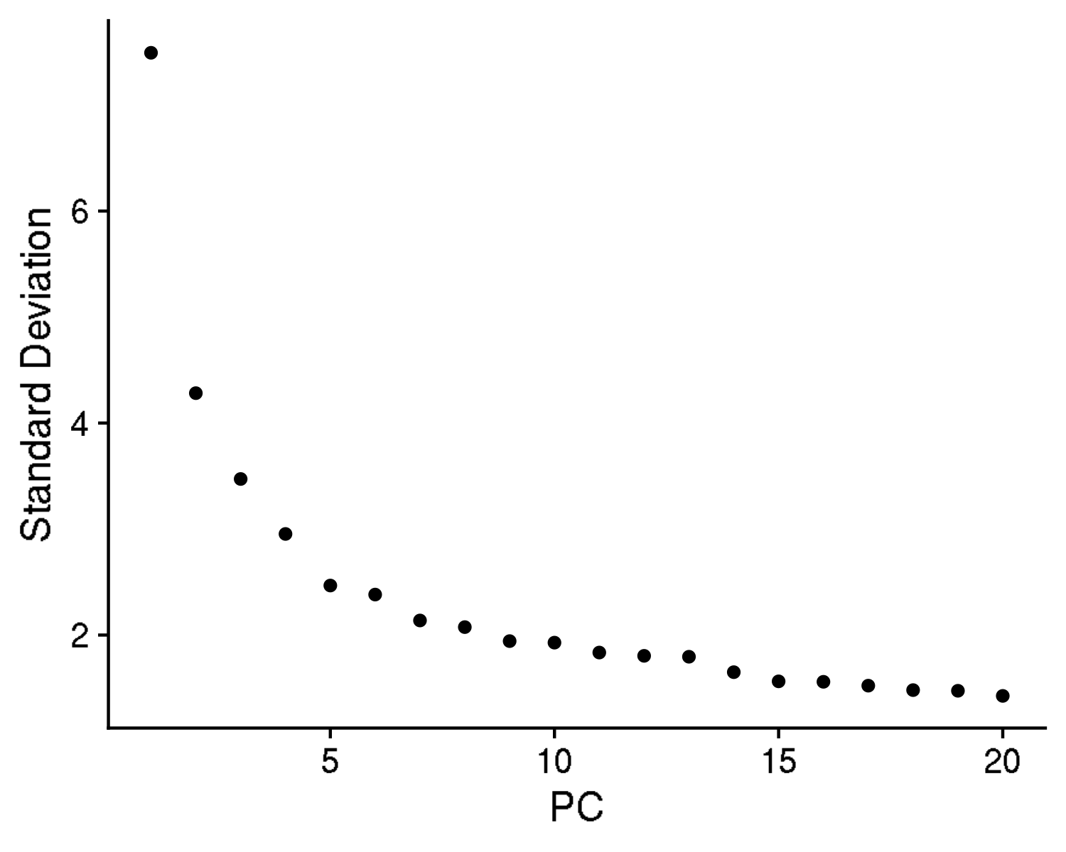
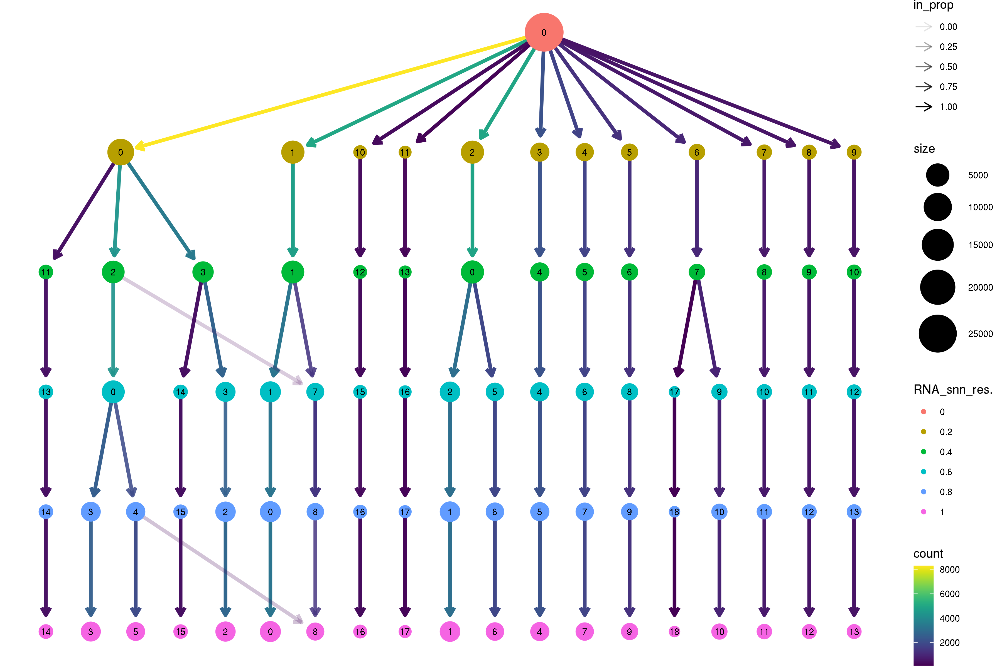
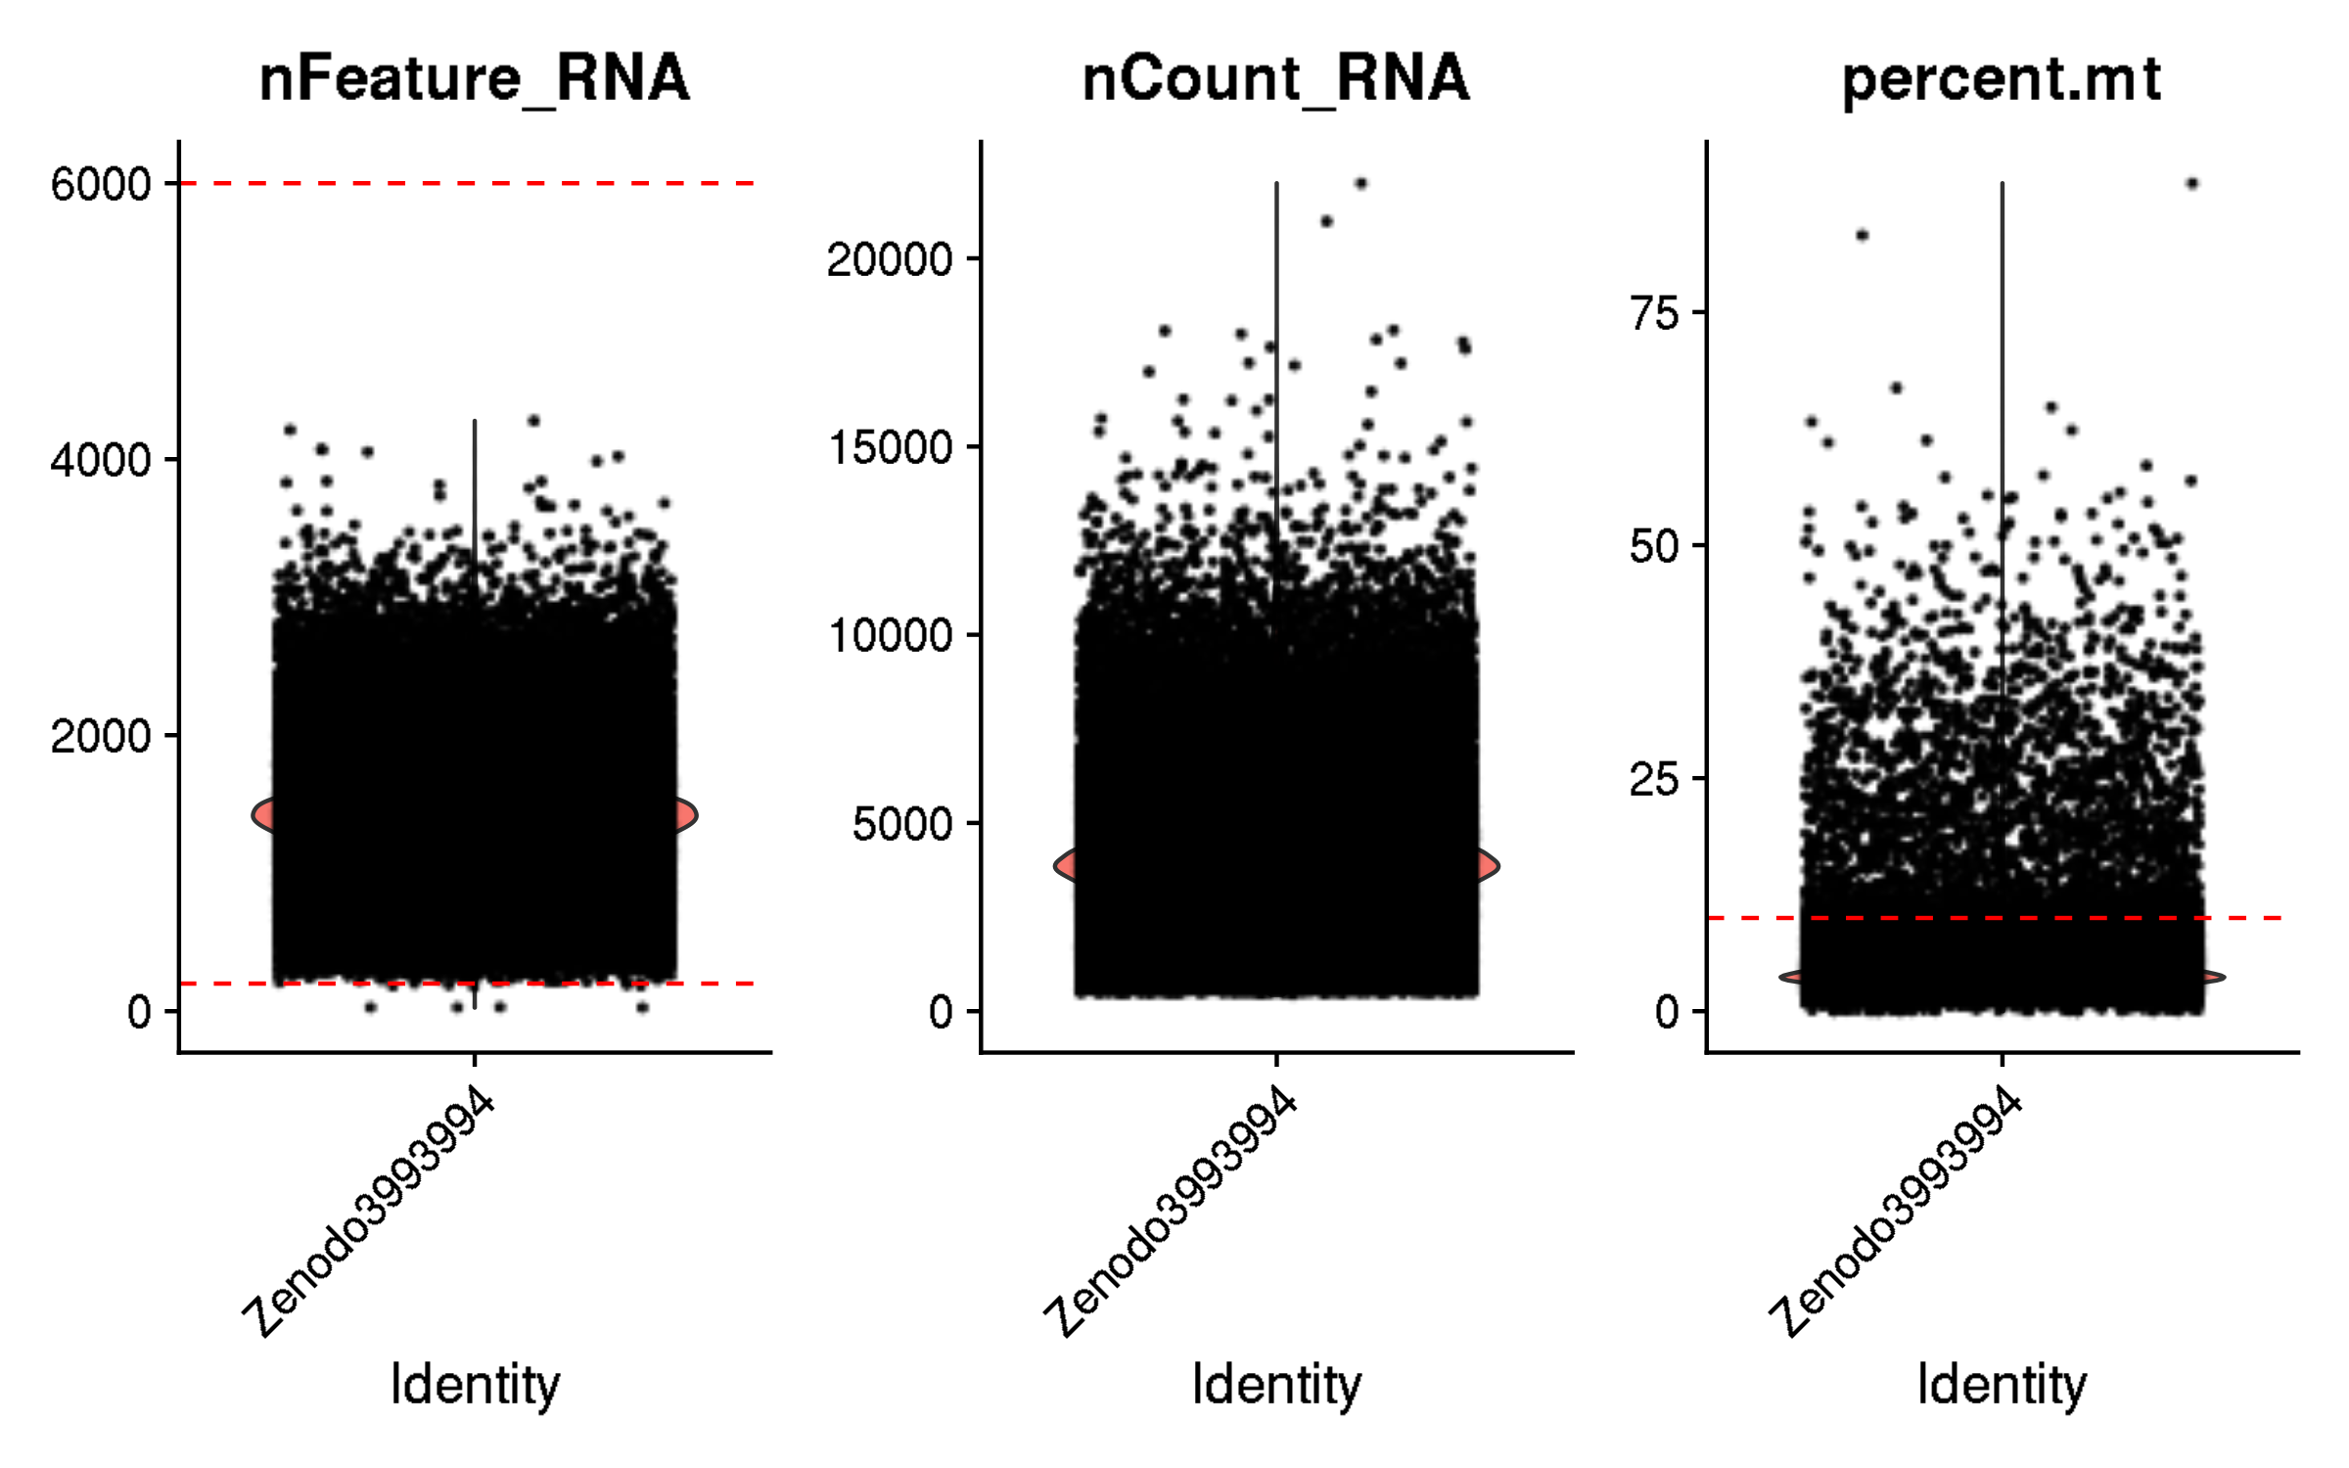
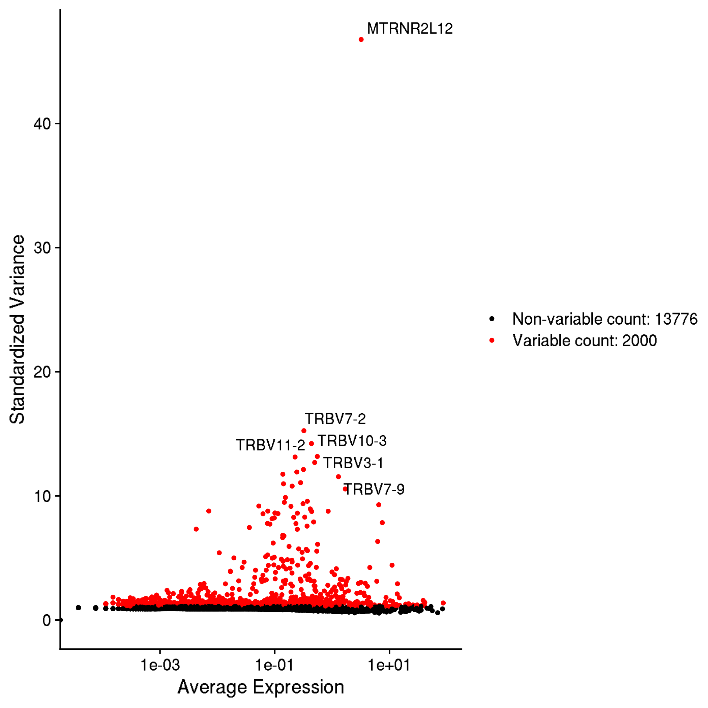
Zenodo3993994: T cells from patients with Parkinson's disease
Inspection and quality control

Slide 2
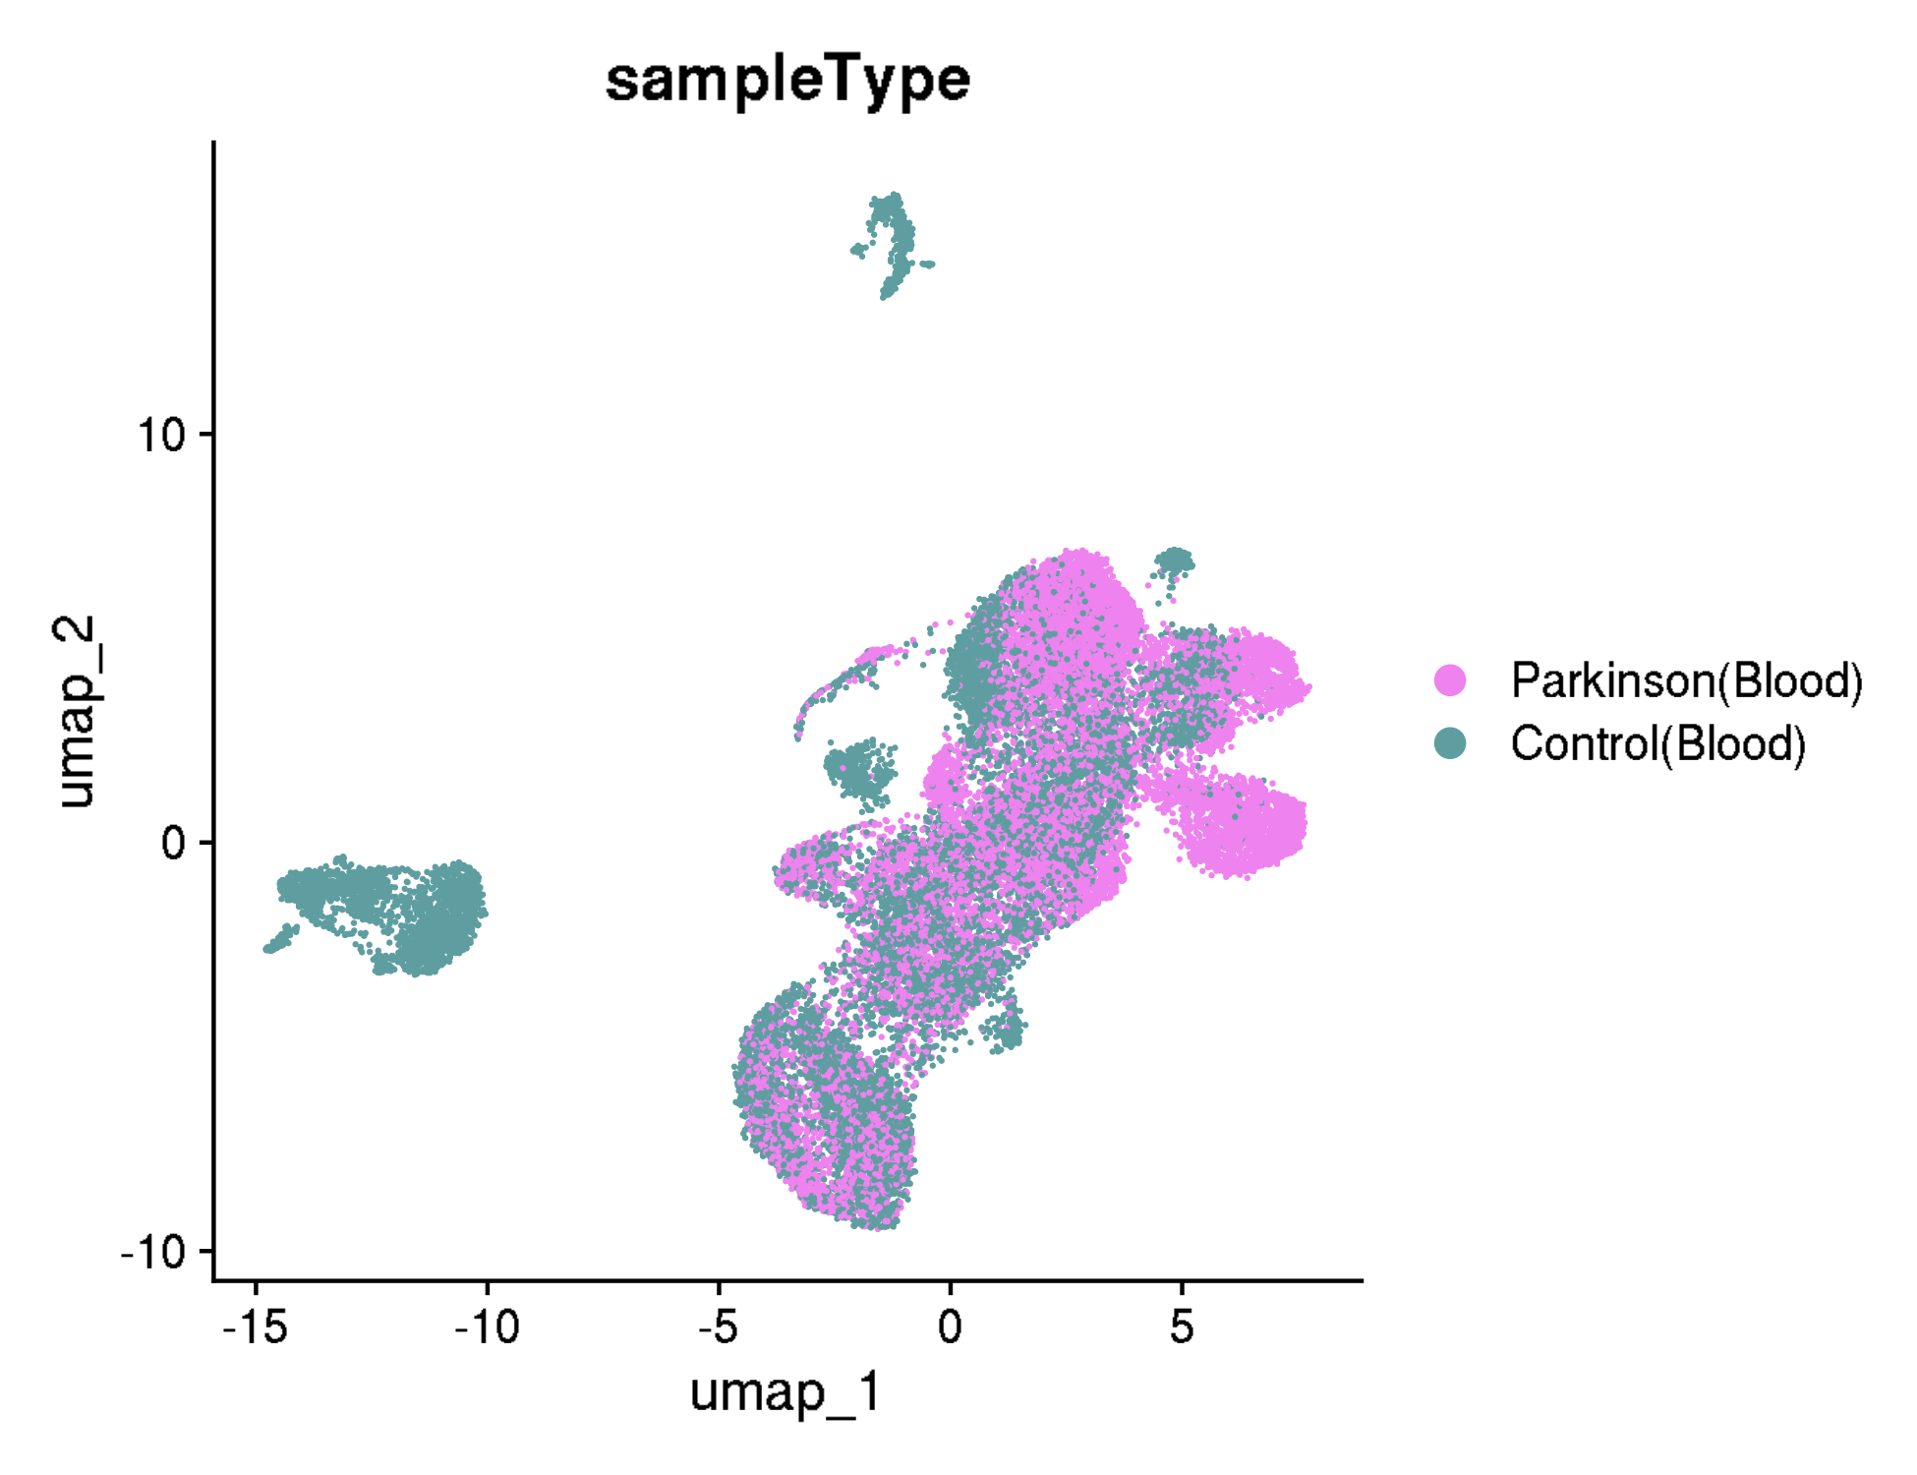
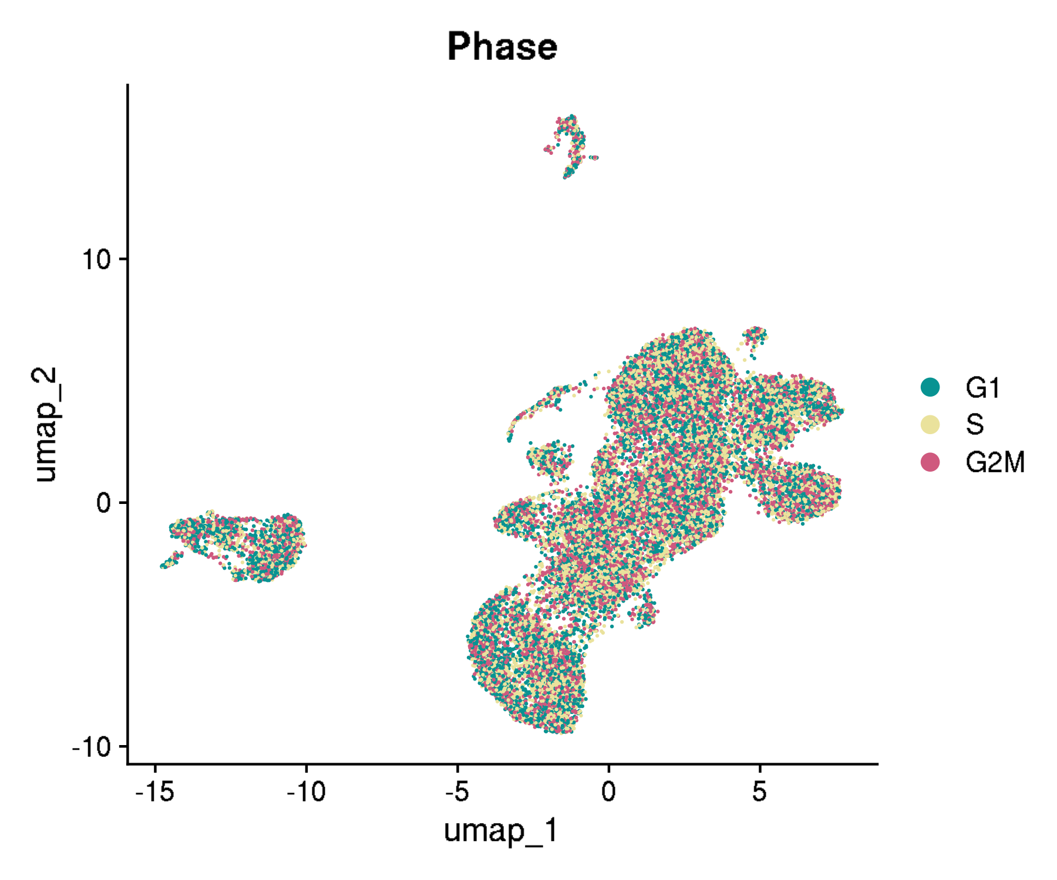
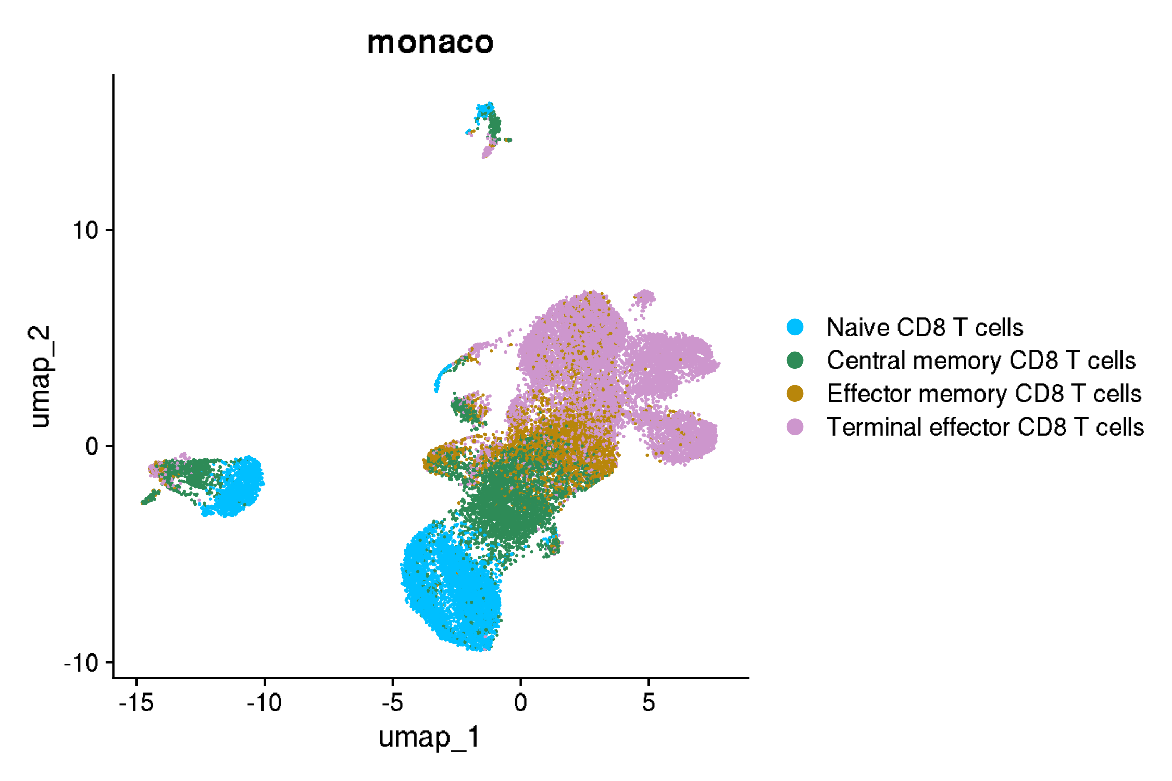
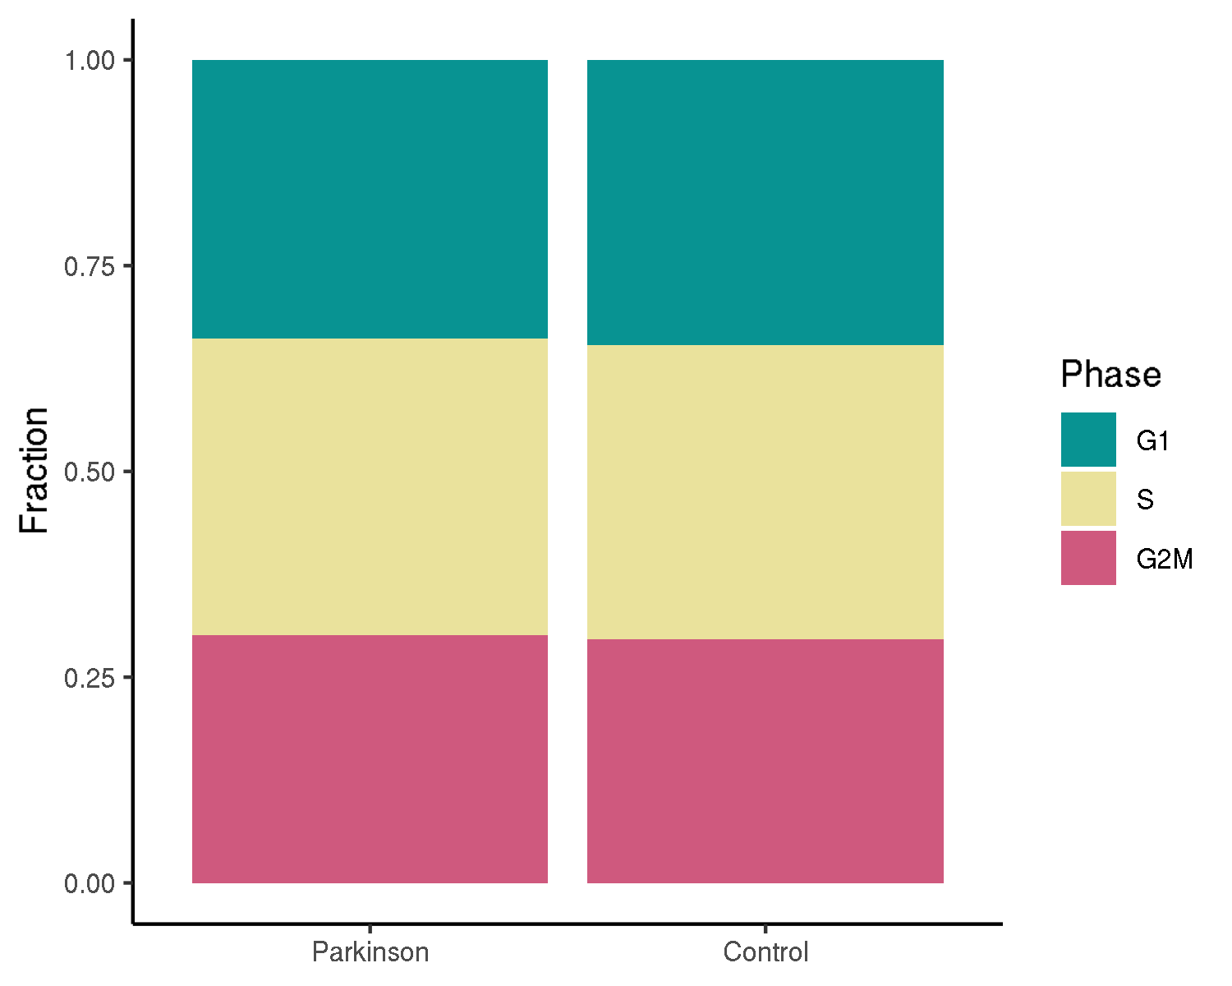
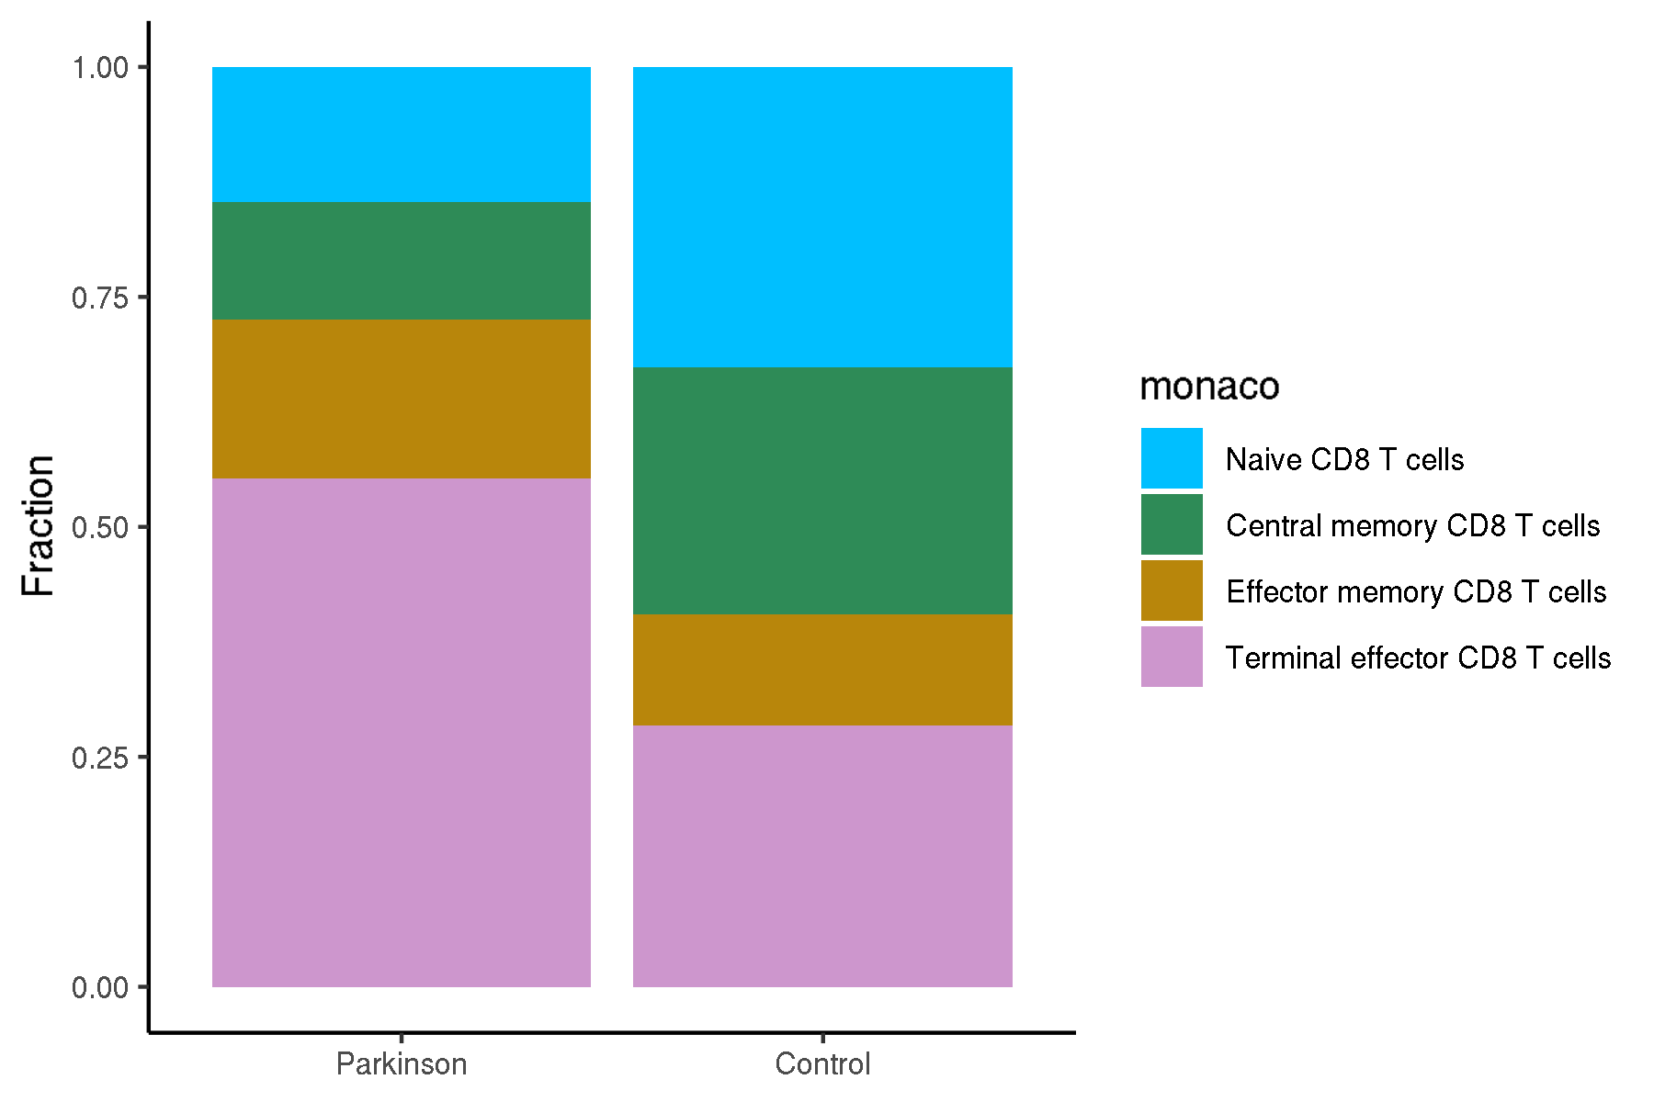
Zenodo3993994: T cells from patients with Parkinson's disease
UMAPs for cell annotations

Slide 3
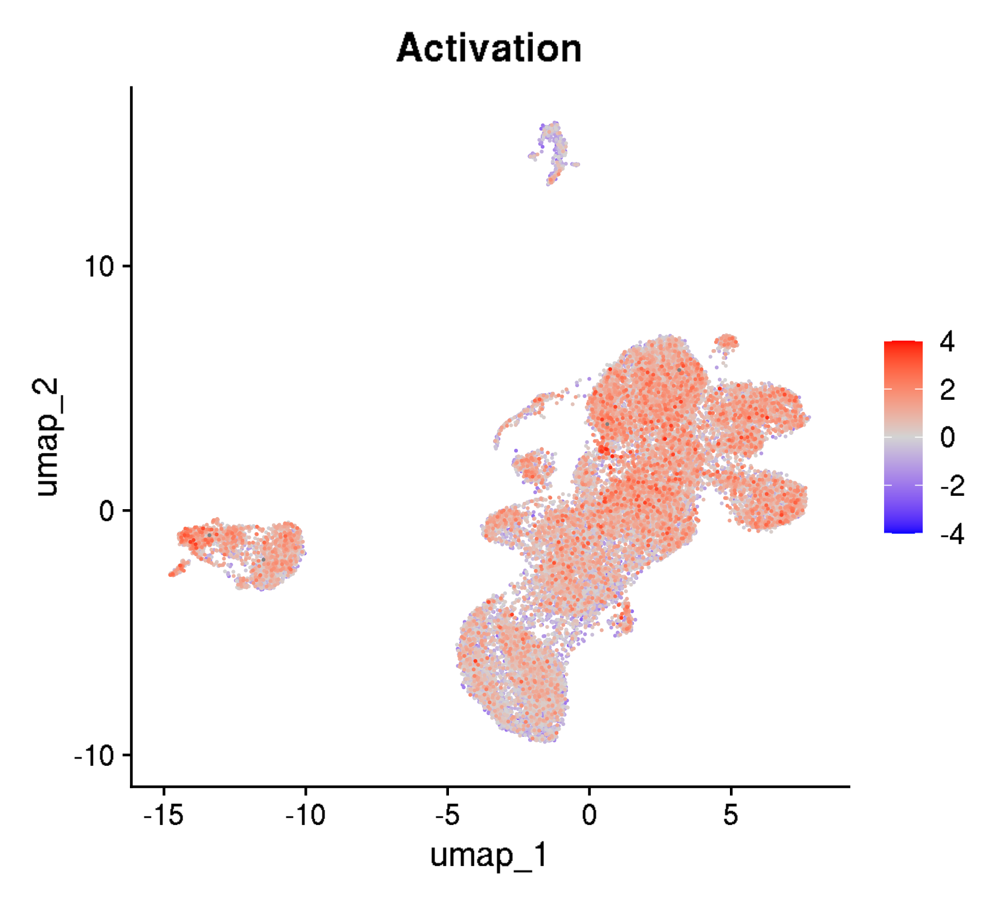
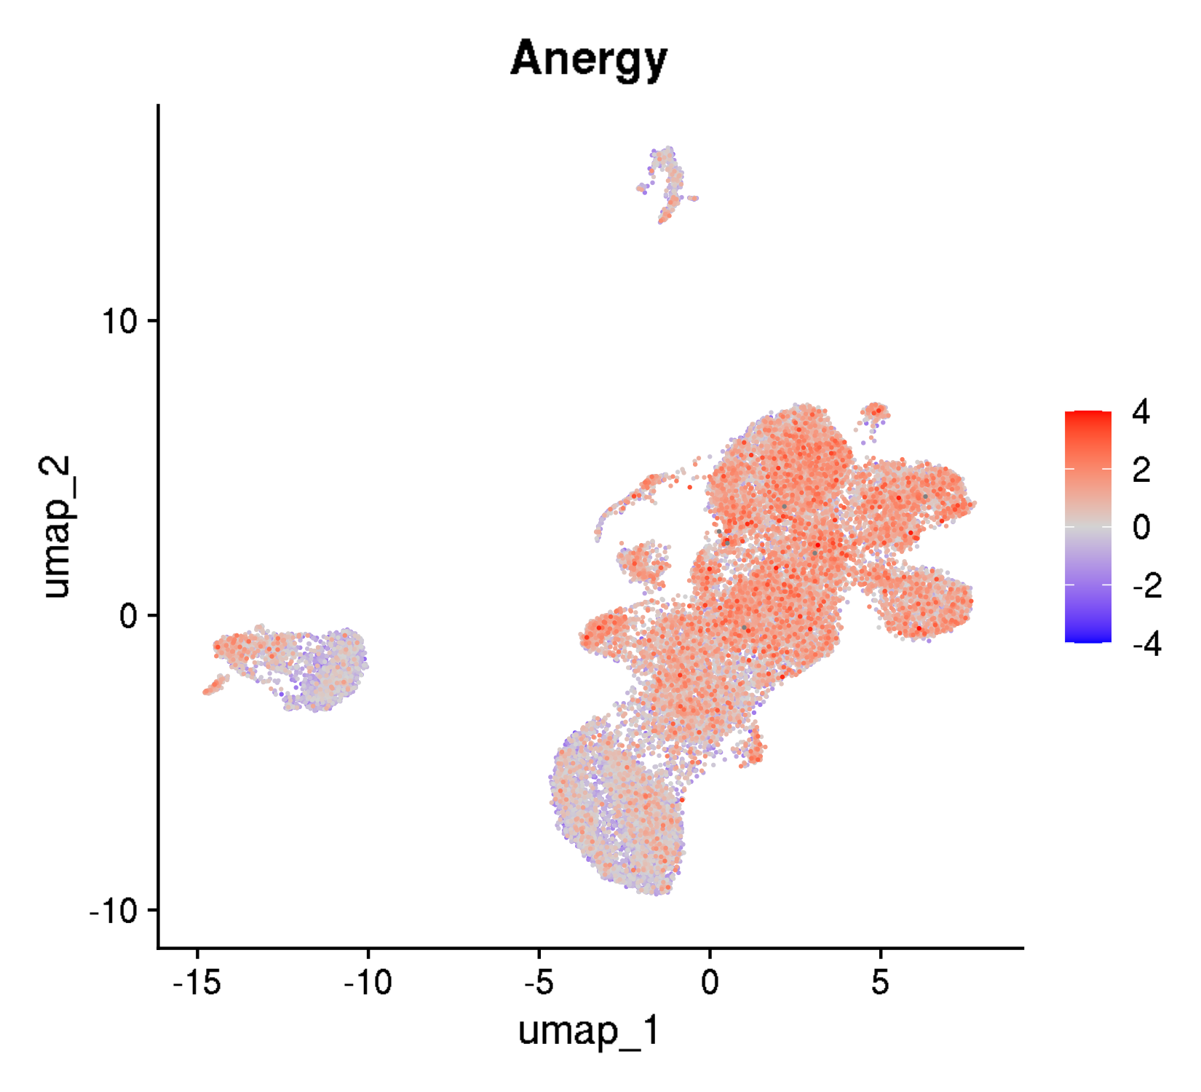

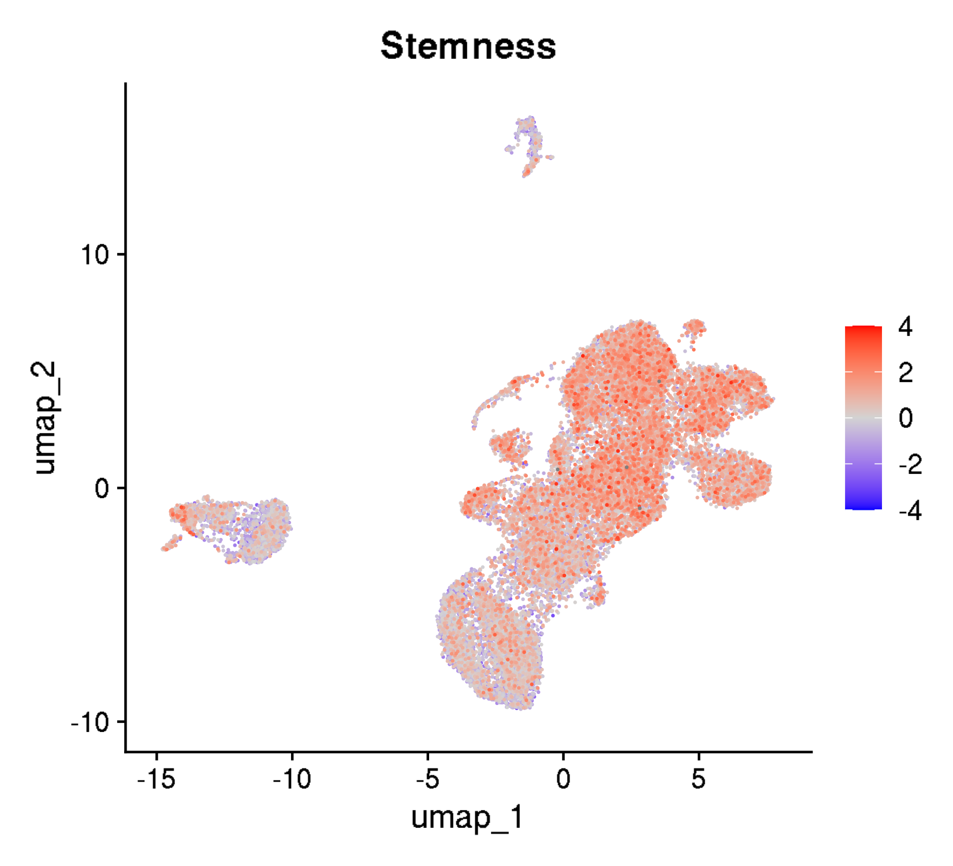
Zenodo3993994: T cells from patients with Parkinson's disease
UMAPs for cell states

Slide 4
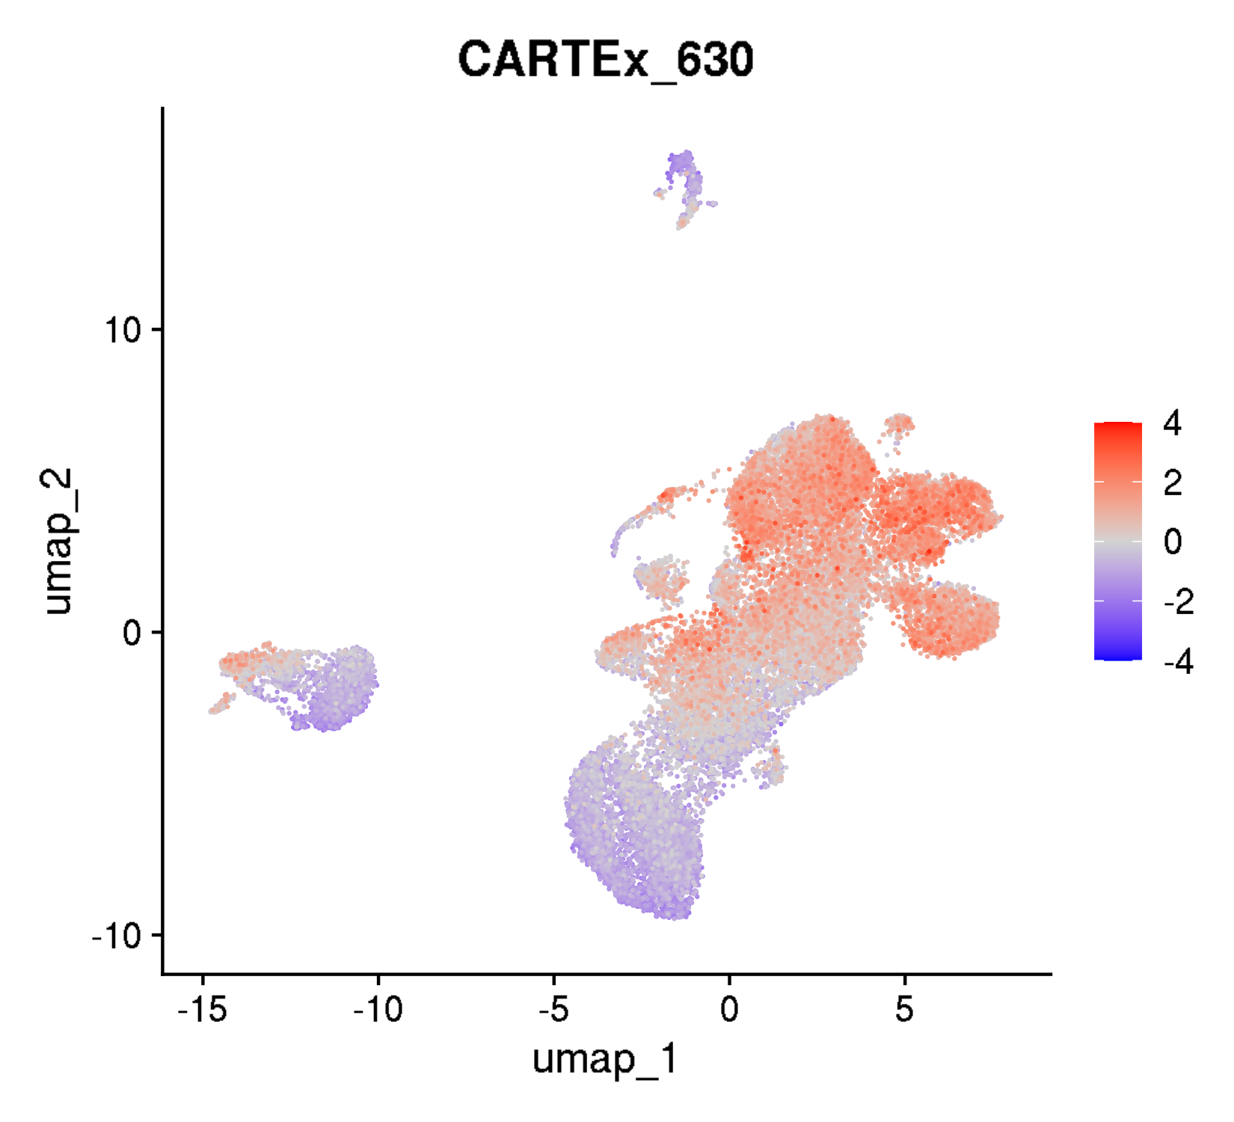
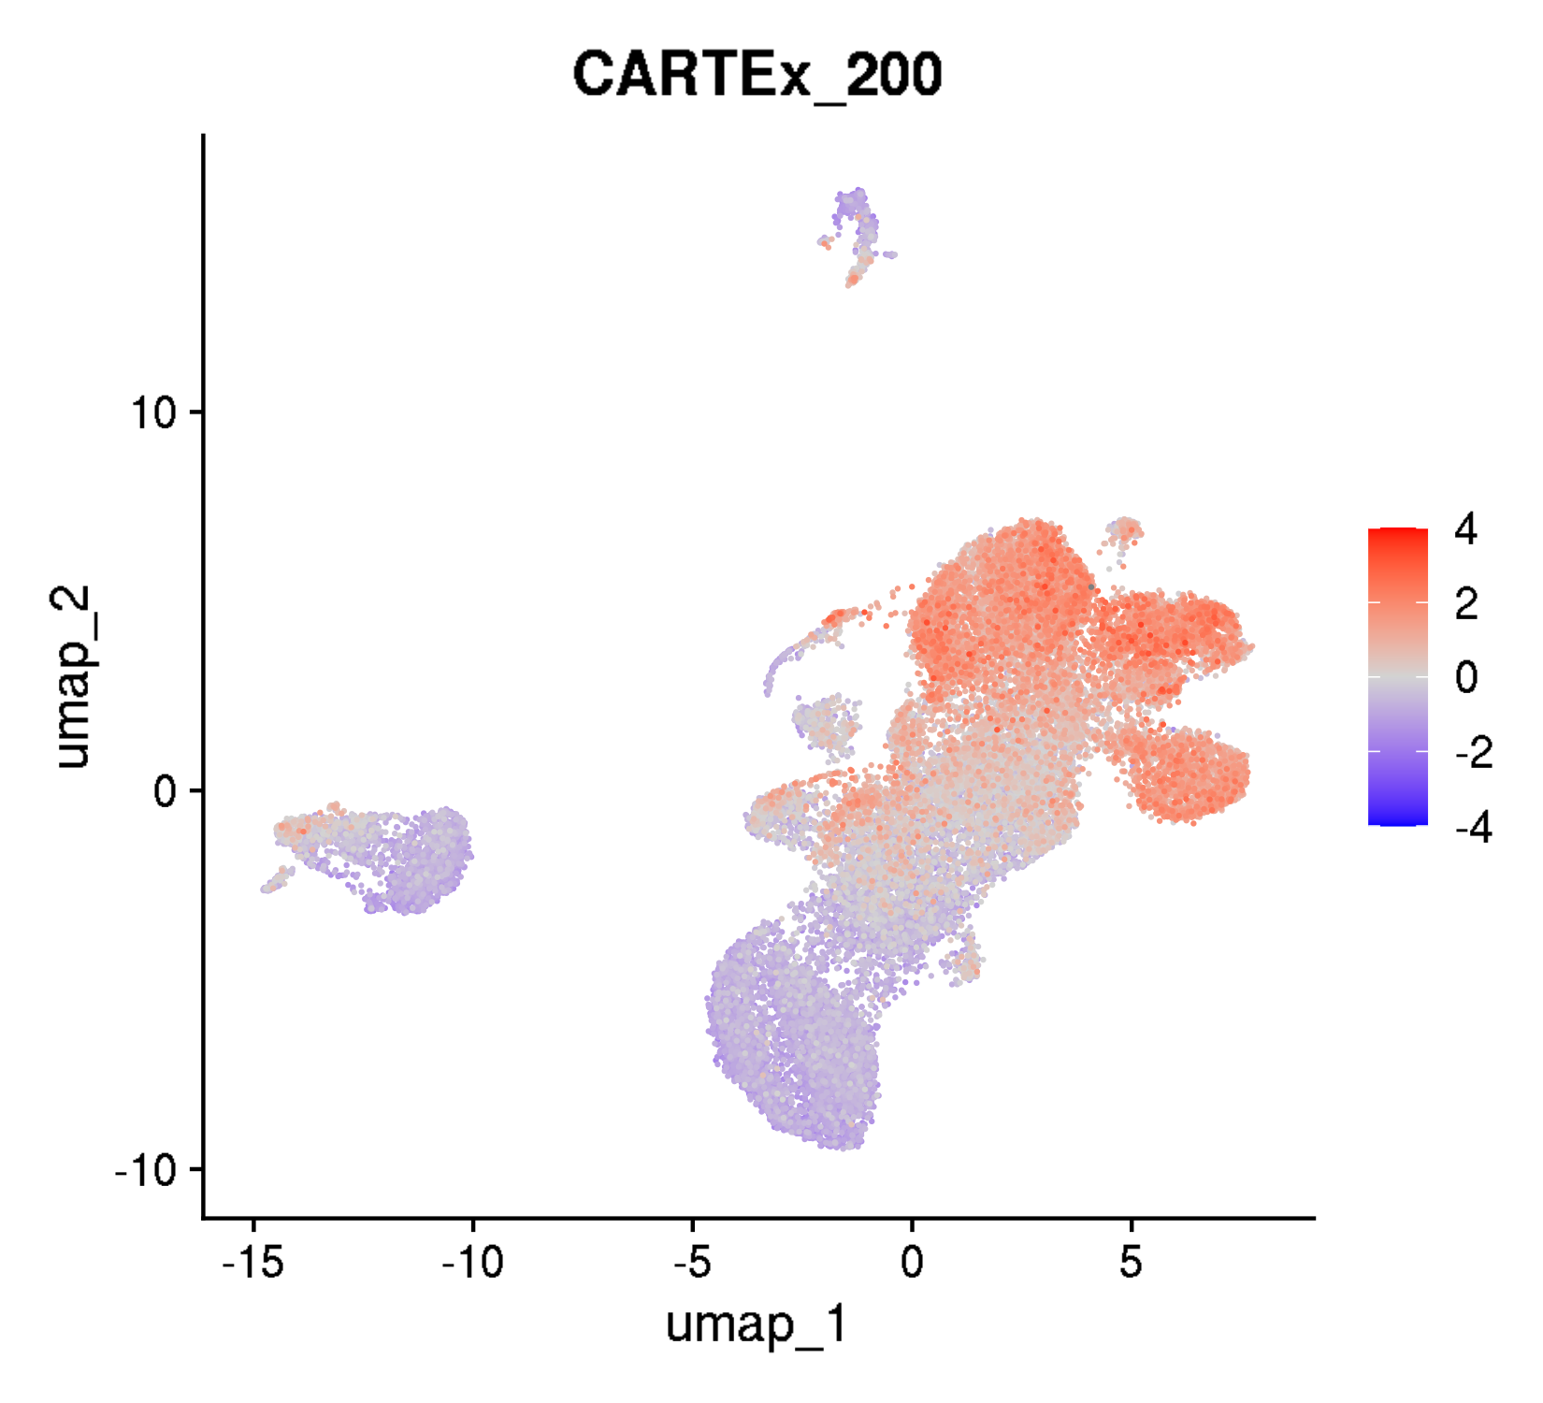
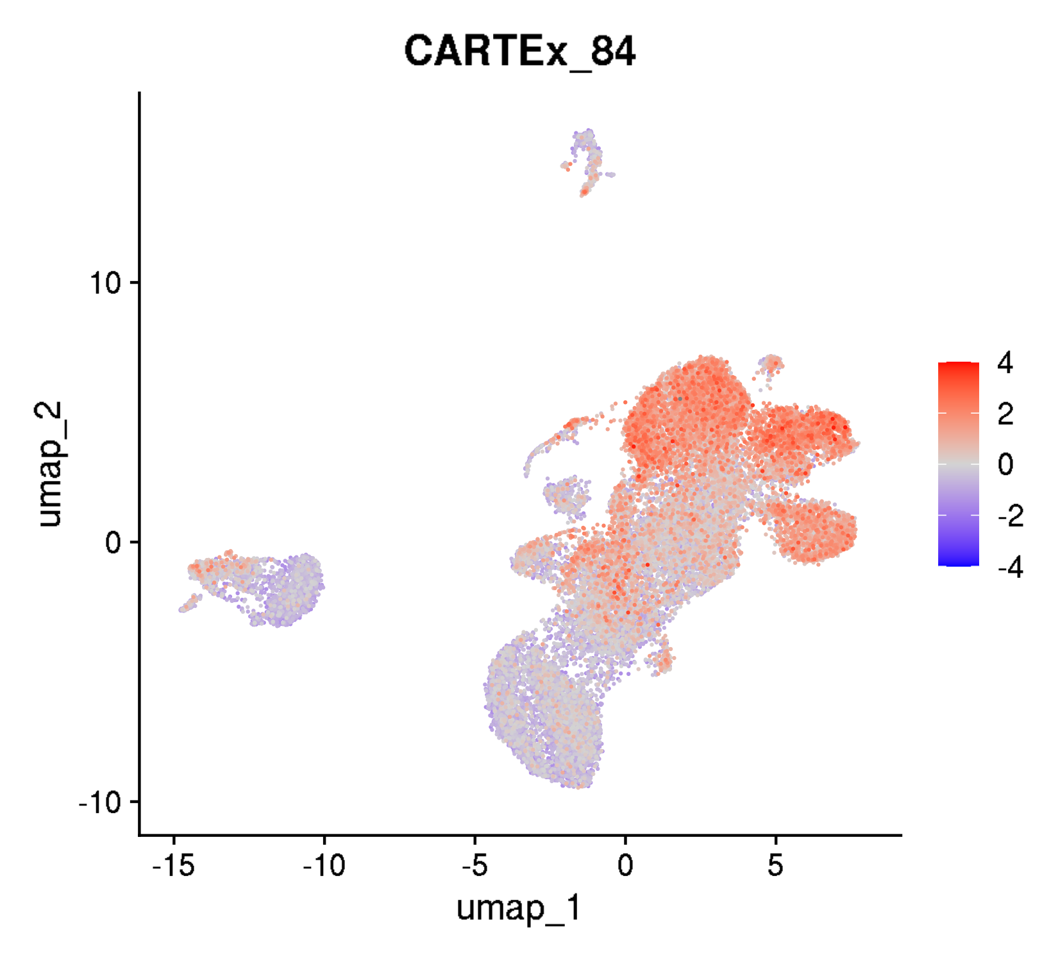
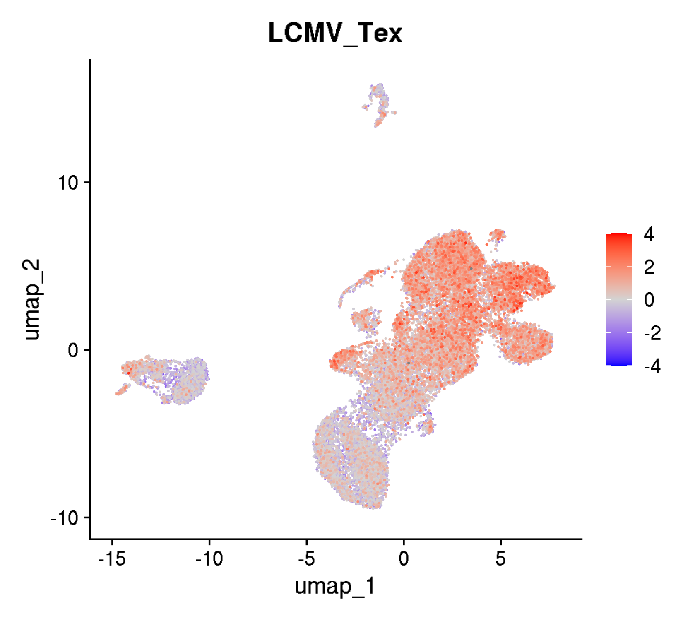
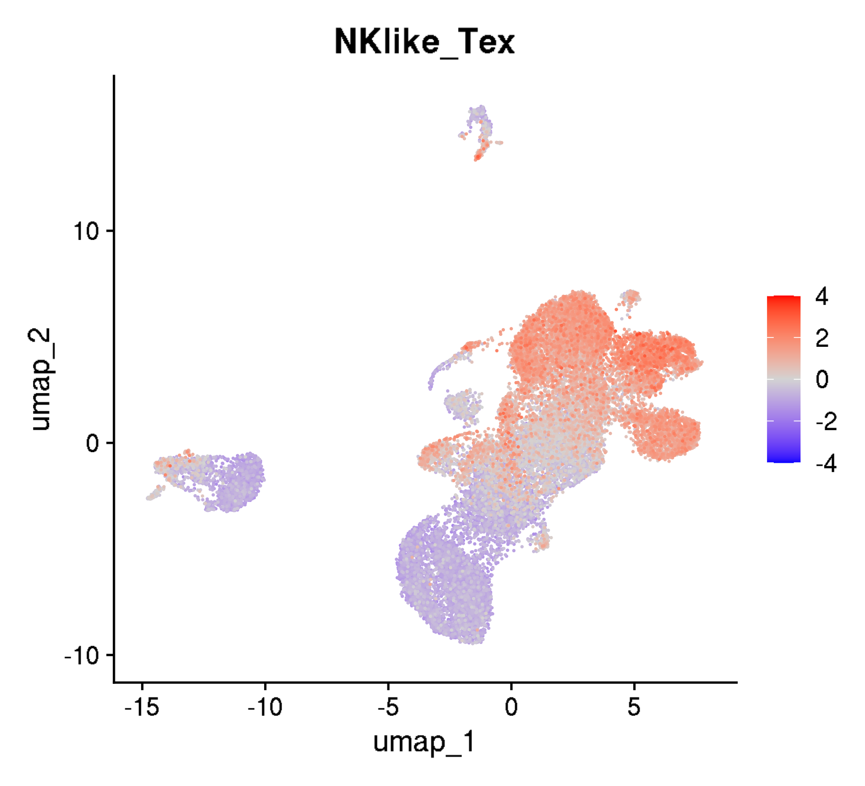
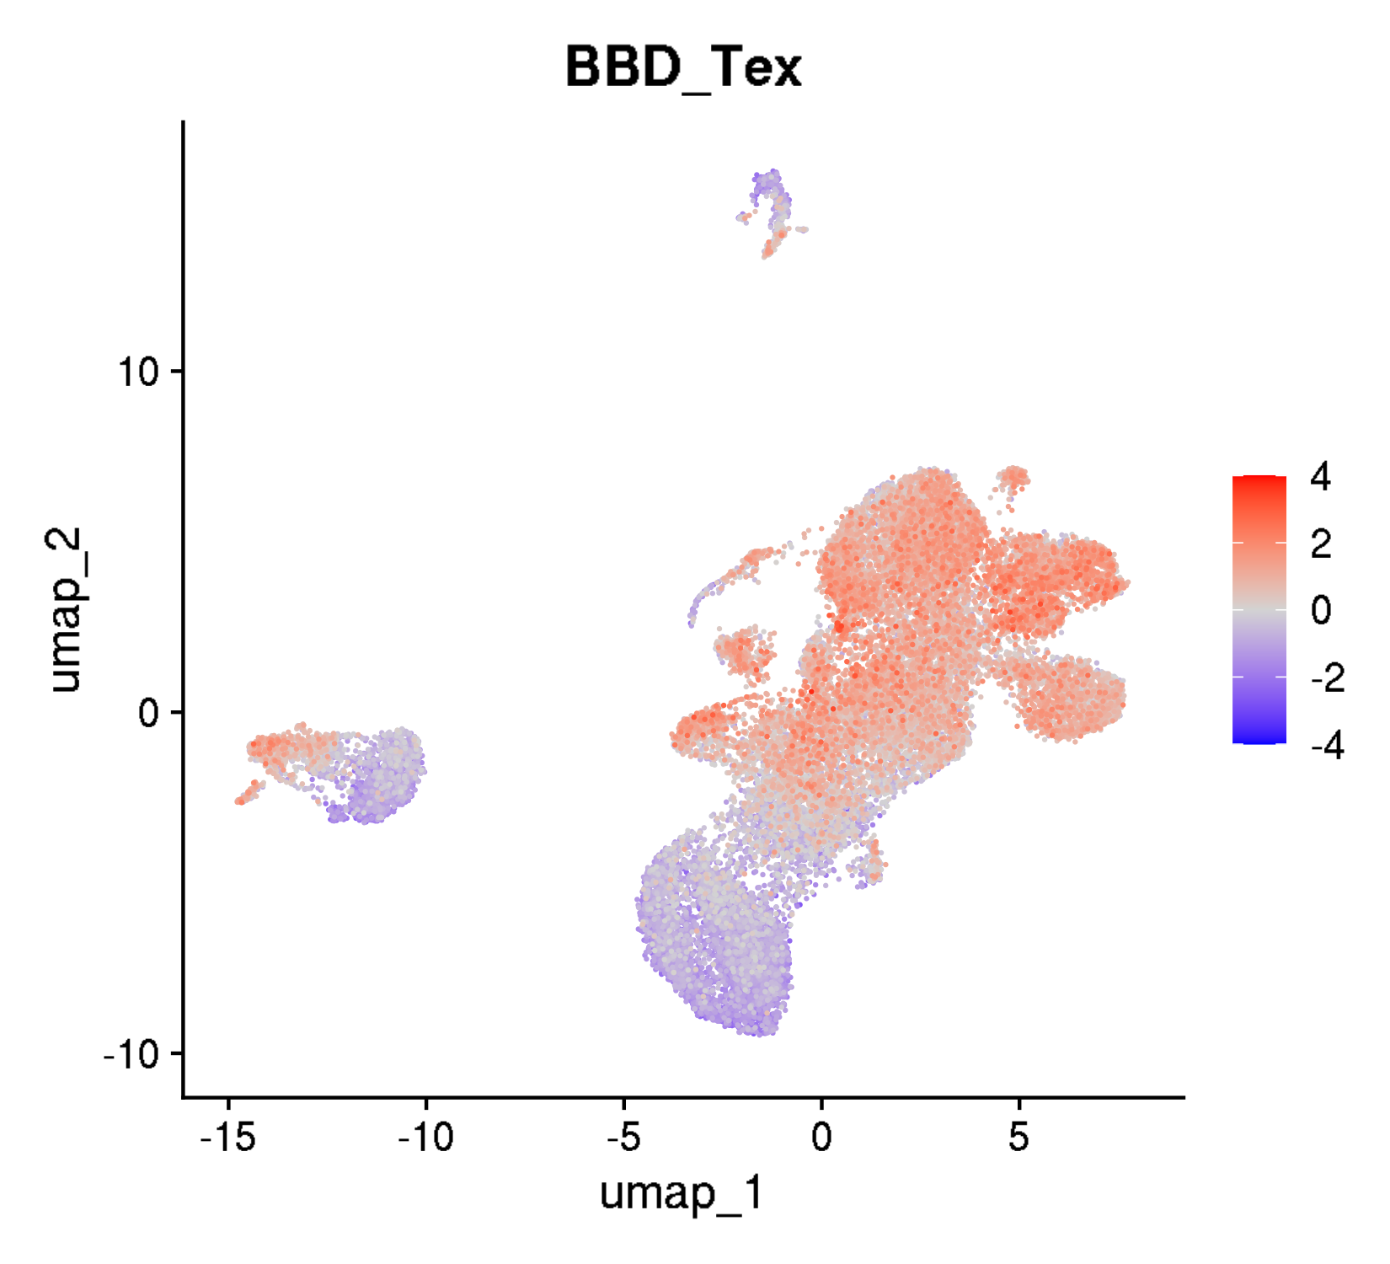
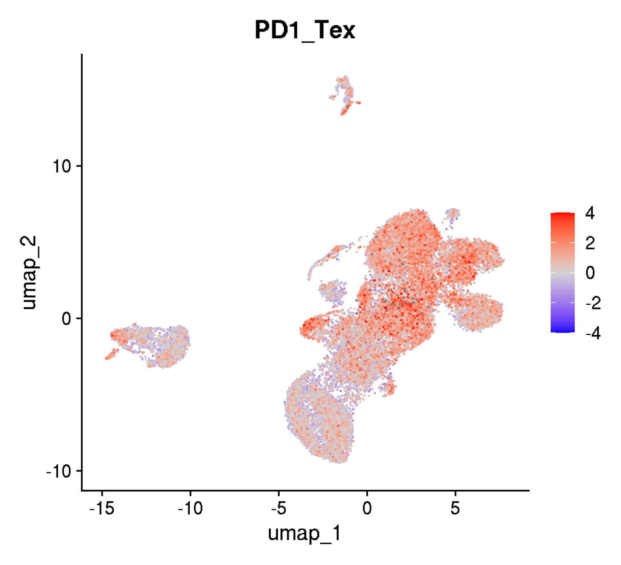
Zenodo3993994: T cells from patients with Parkinson's disease
UMAPs for exhaustion scores

Slide 5
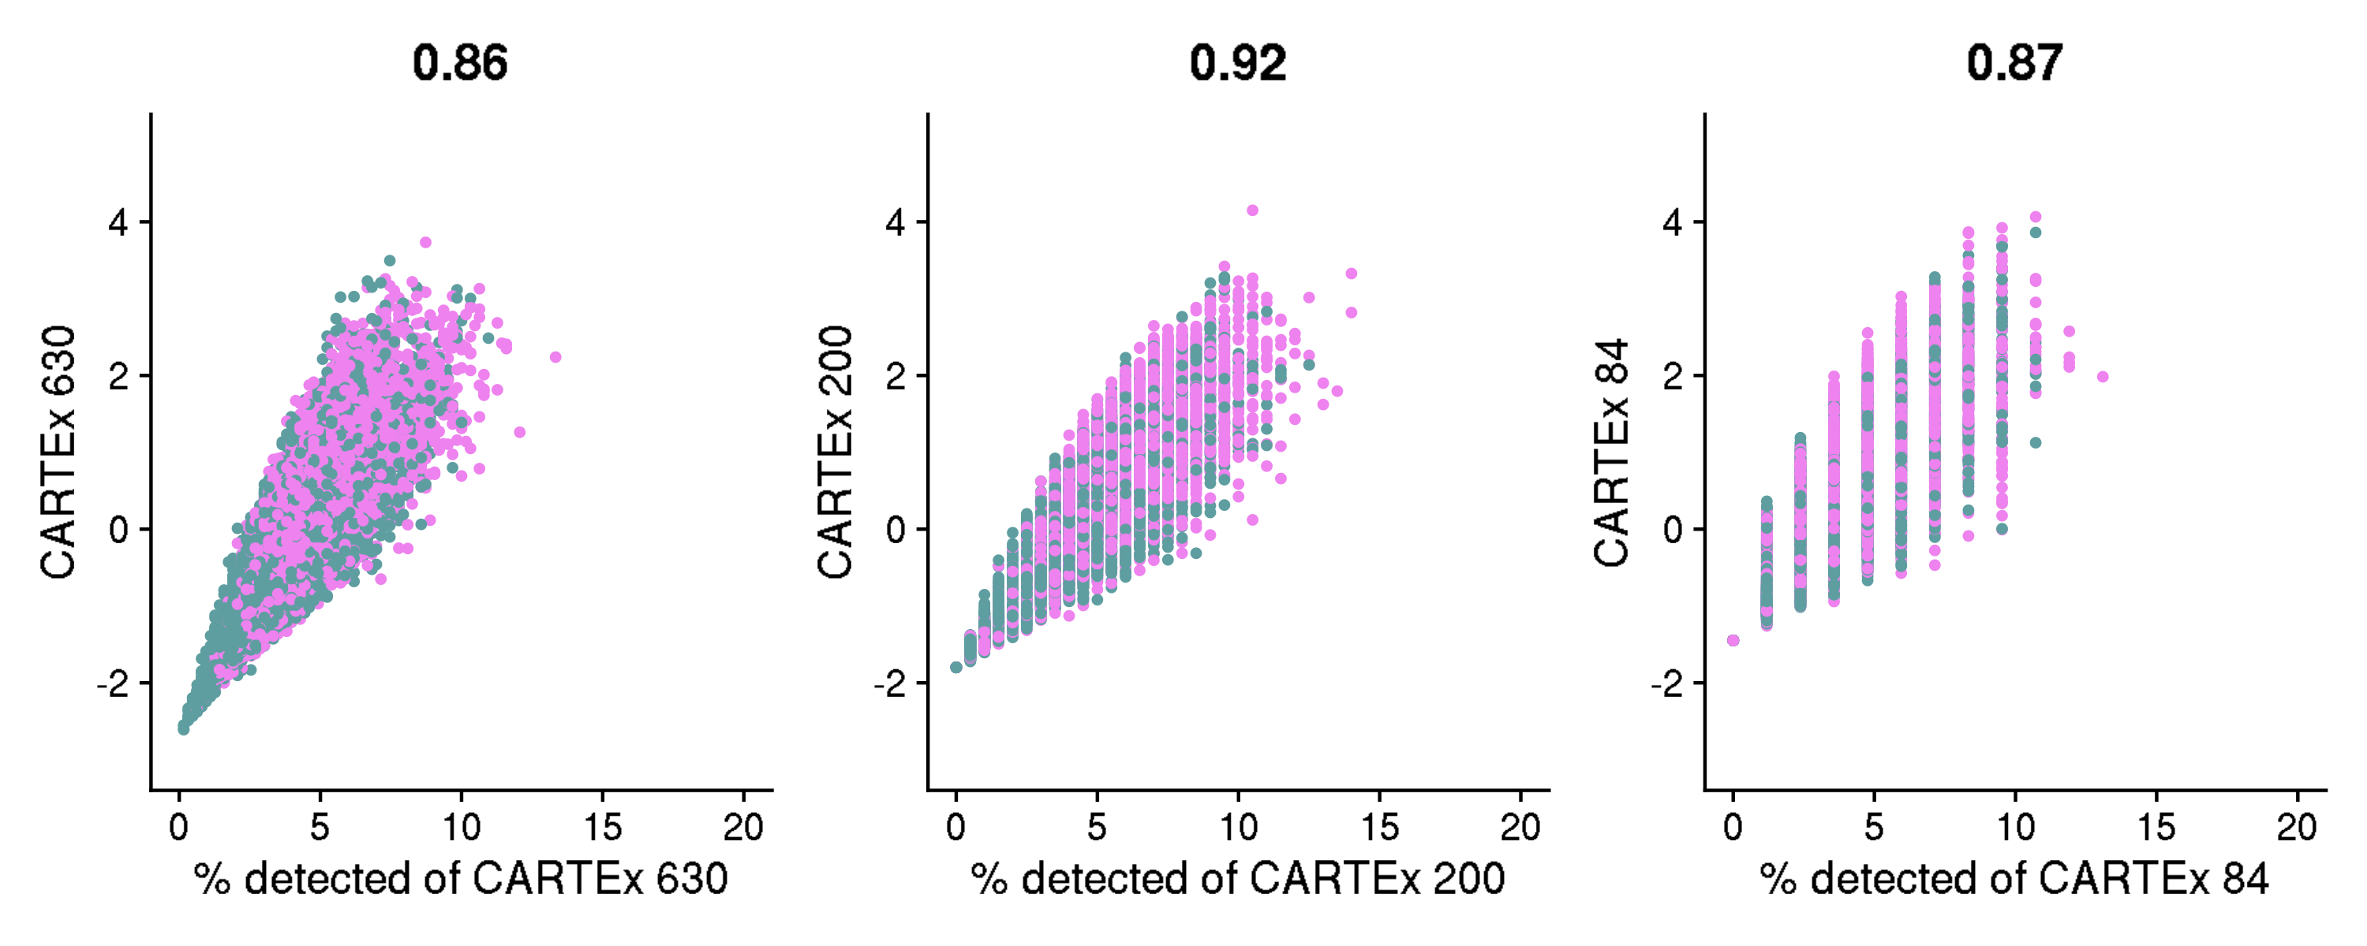
Zenodo3993994: T cells from patients with Parkinson's disease
Percentage of CARTEx detected

Slide 6
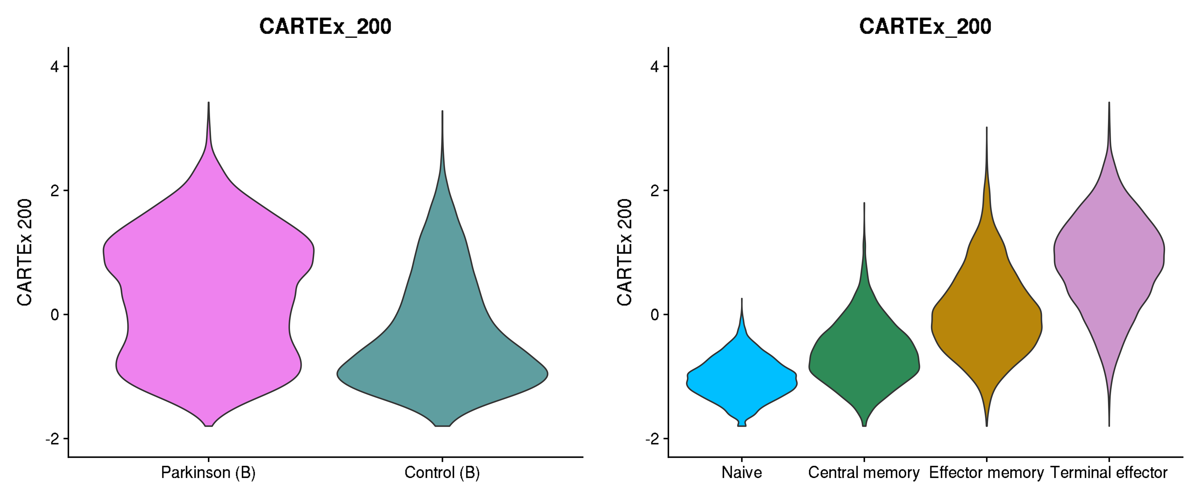
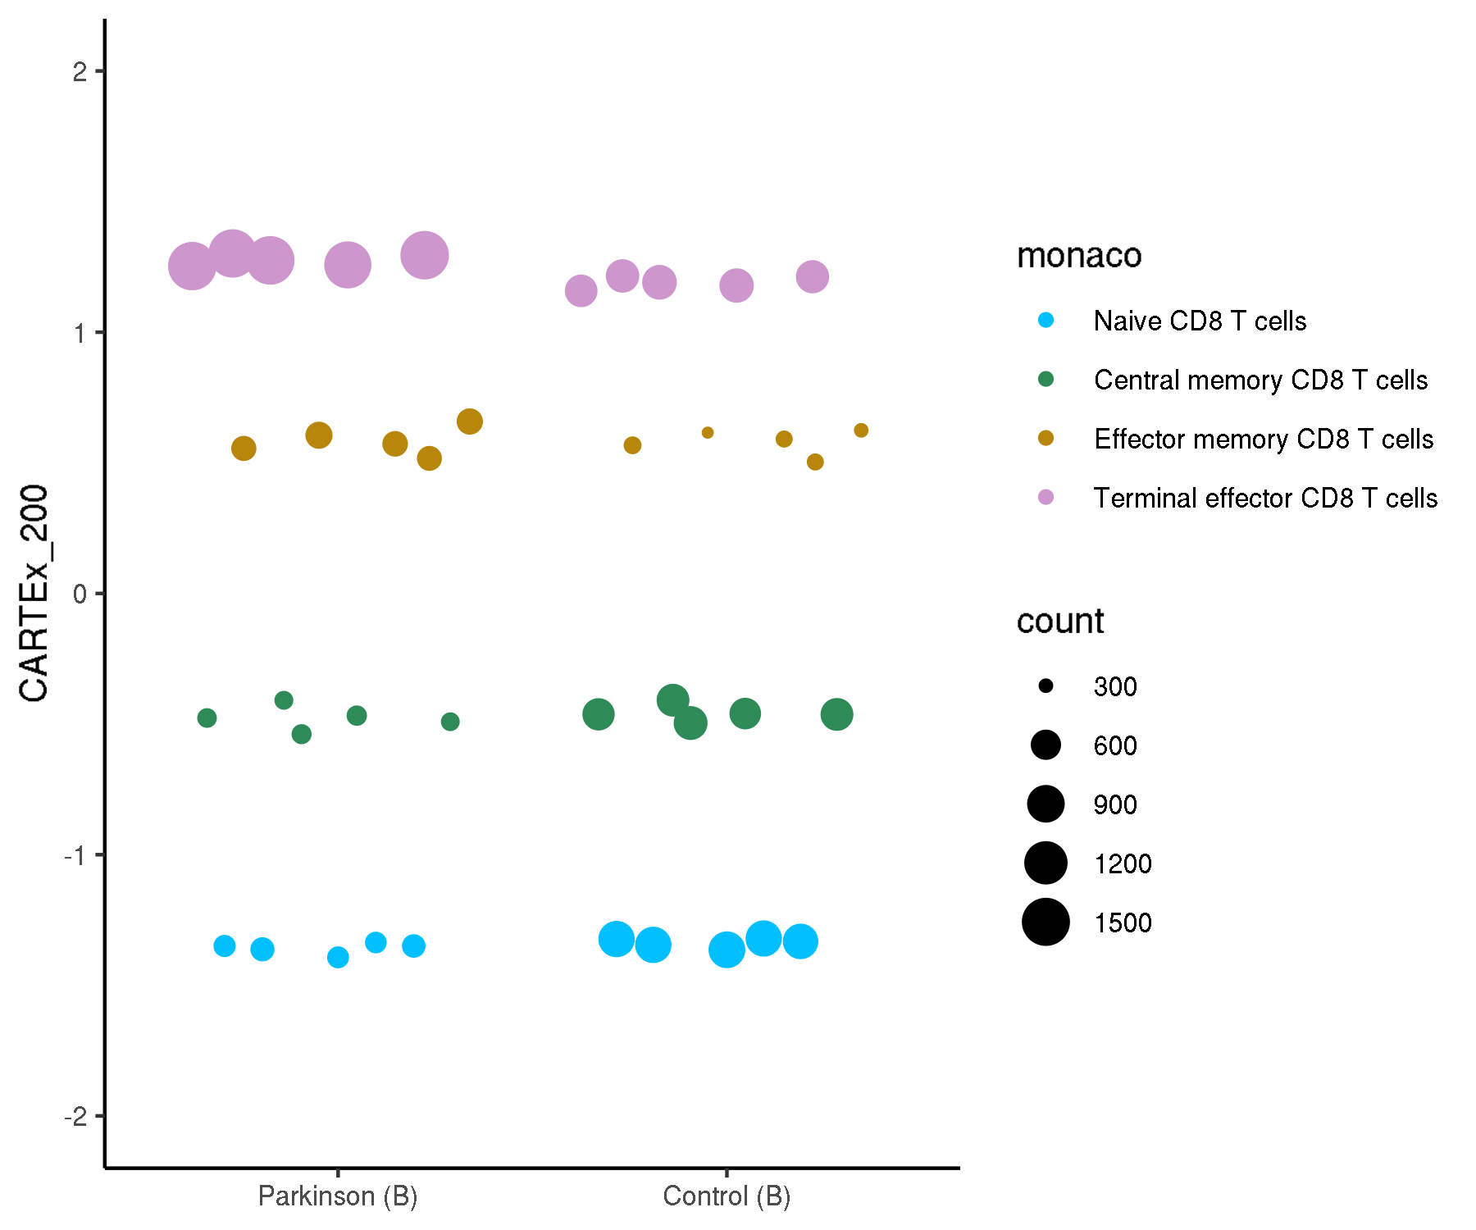
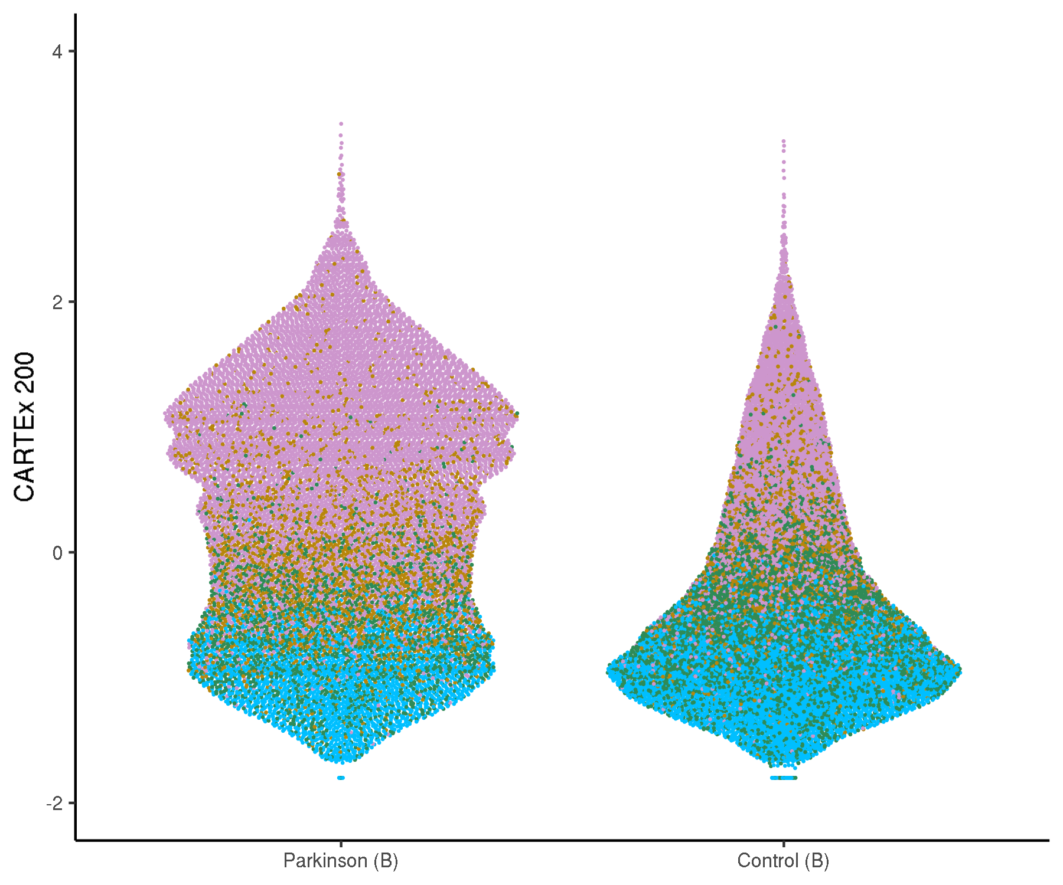
Zenodo3993994: T cells from patients with Parkinson's disease
Cell type differentiation

Slide 7
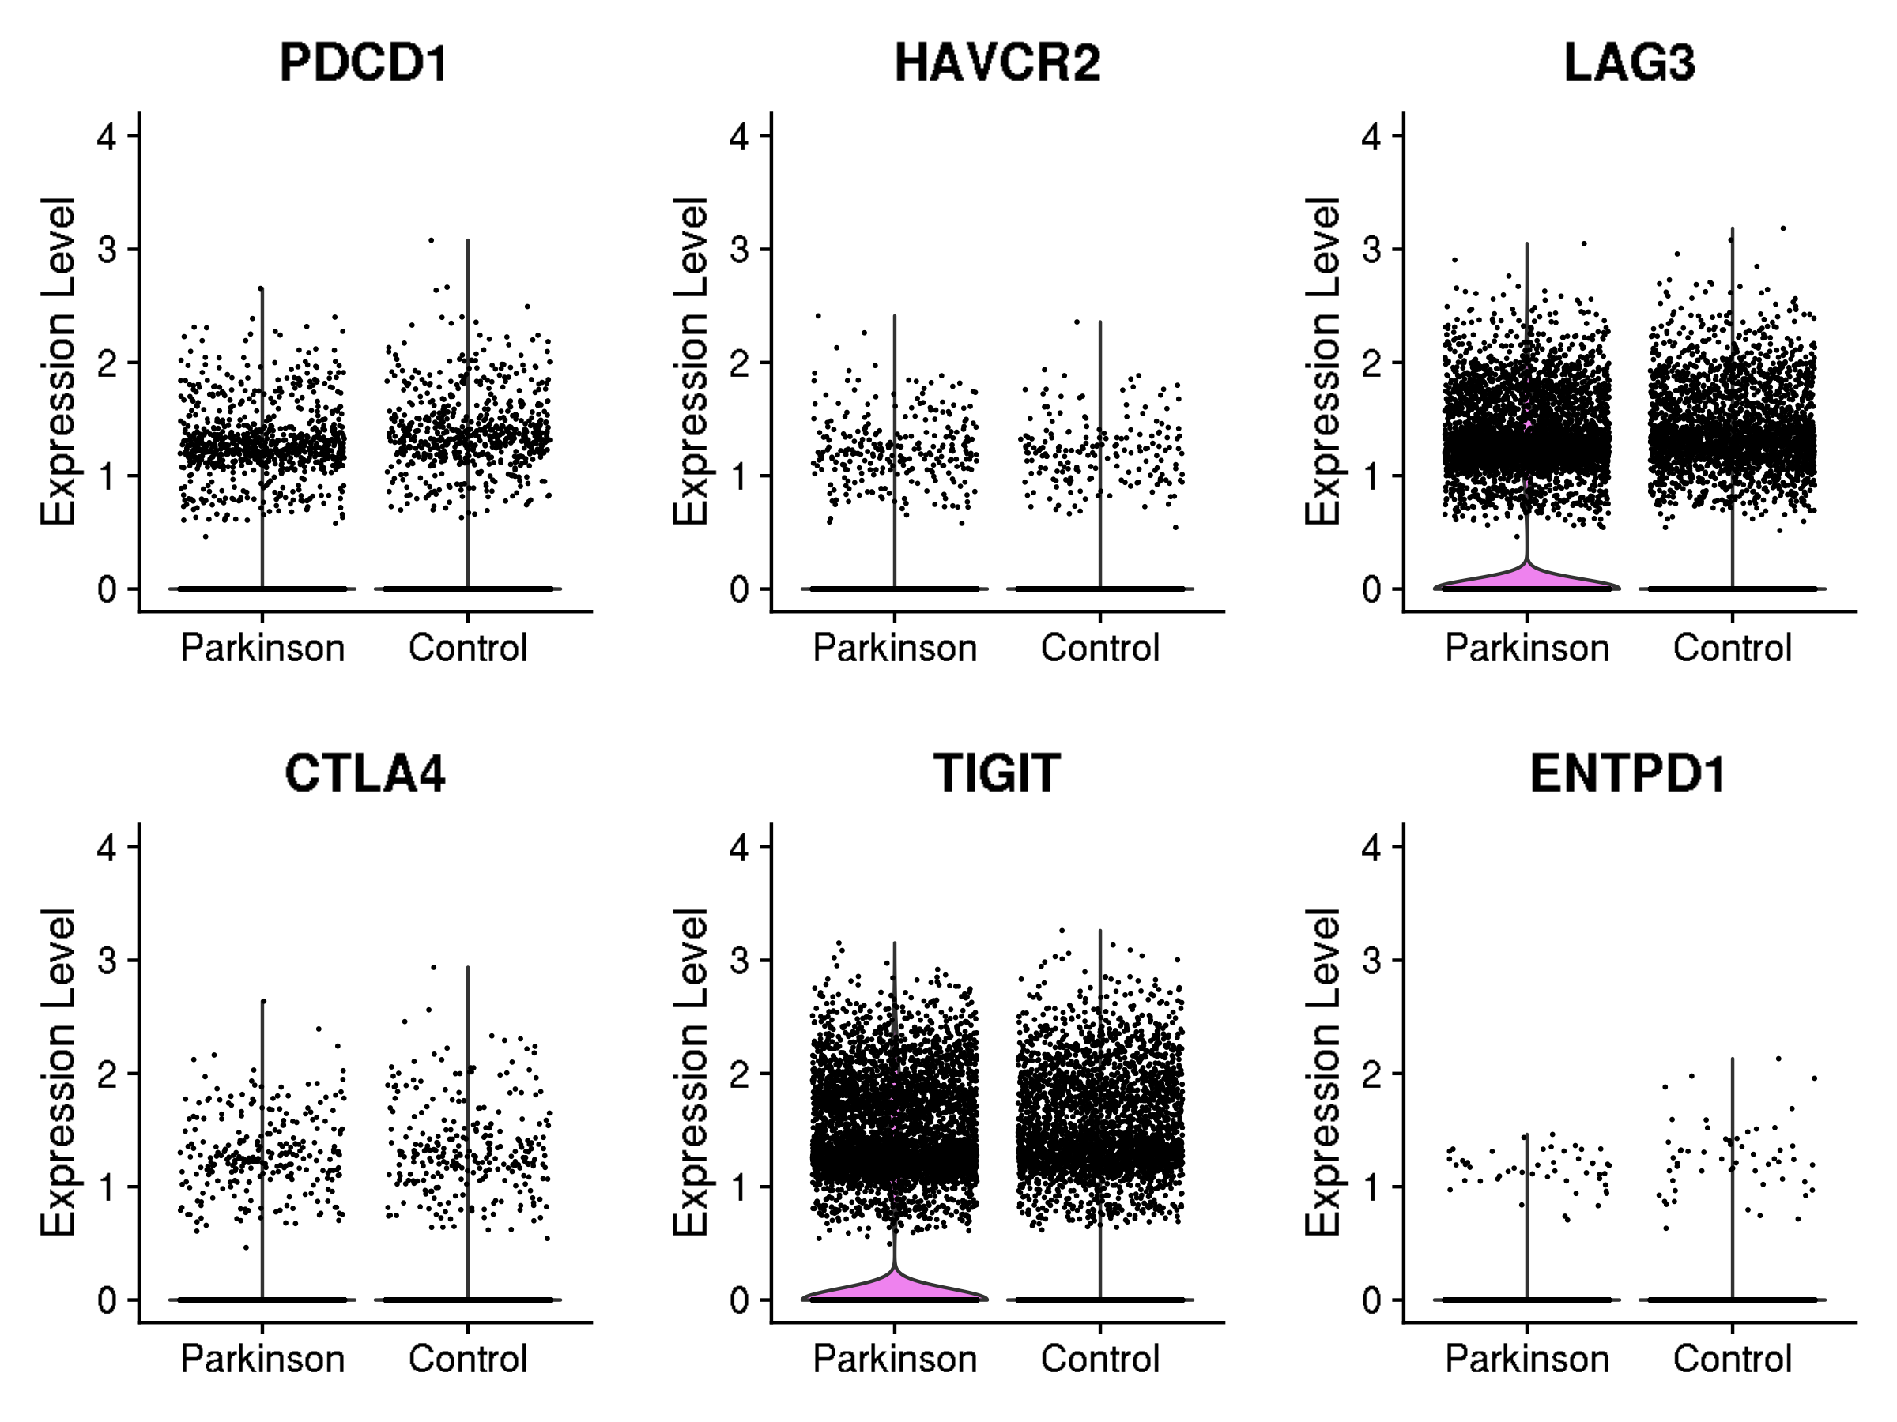
Zenodo3993994: T cells from patients with Parkinson's disease
Violin plots for canonical exhaustion markers
Gene and corresponding protein
PDCD1 encodes PD-1
HAVCR2 encodes TIM-3
LAG3 encodes LAG-3
CTLA4 encodes CTLA-4
TIGIT encodes TIGIT
ENTPD1 encodes CD39

Slide 8
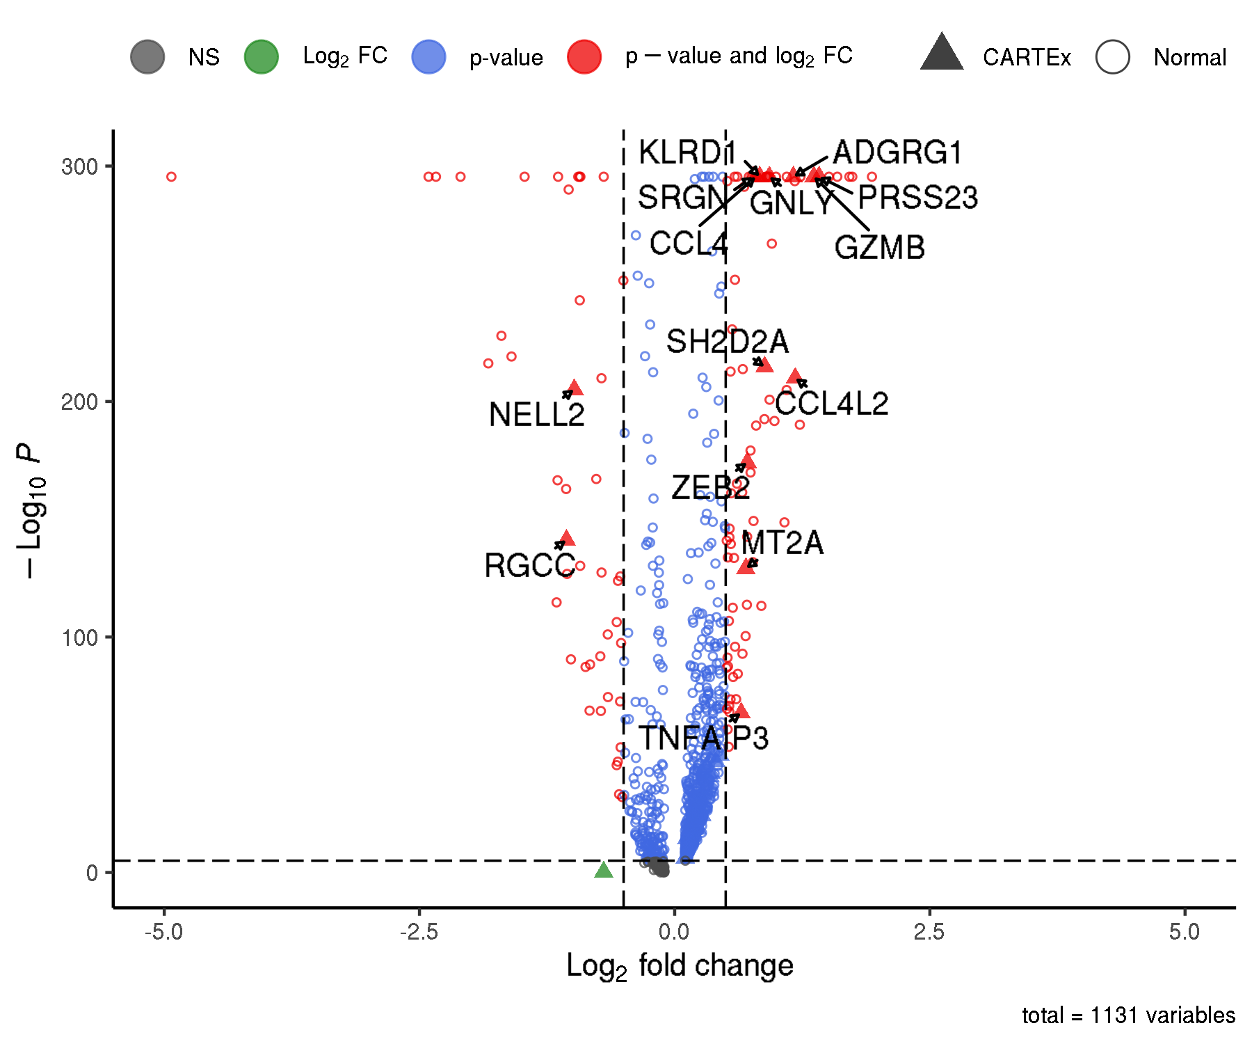
Zenodo3993994: T cells from patients with Parkinson's disease
Differentially expressed genes

